Slide 1
College Degree Levels
Part 2
College Prep
Mr. Gordon
jgordon@bisdtx.org

Slide 2
Upcoming Events
Frid. Oct. 8th No School
Mon. Oct. 11th BISD Holiday, but 11th graders still have ACC
Thurs. Oct. 14th 6PM CRCA in BISD Homecoming Parade
Sat. Oct. 16th 8AM-2PM 11th Grade PSAT
Fri. Oct. 29th 4:10-9:00 PM CRCA Lock-In $5 Please pay Mr. Gordon
hi

Slide 3
College Degree Levels
College degrees are divided into four categories:
Associate Degree
Bachelor’s Degree
Master’s Degree
Doctoral Degree
You will hear these terms used often at CRCA when discussing College and Career.
hi

Slide 4
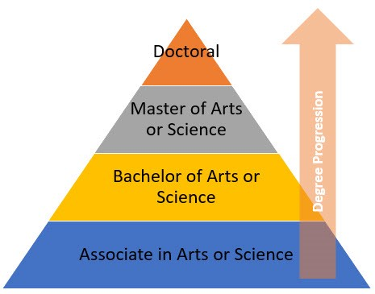
College Degree Levels
hi

Slide 5
Master’s Degree
Only 13.1% of the US population has a Master’s or Doctorate degree.
Students who want to specialize in a certain field obtain their Master’s degree.
Some careers require a Master’s degree or higher,
such as College Professor, Doctor, and Lawyer.
Some careers require a Master’s if you want to supervise others or work at a higher level, such as education and engineering.
hi

Slide 6

Master’s Degree
Must have already graduated with a Bachelor’s degree
Usually takes 2 years to complete
Must complete 30-36 credit hours
hi

Slide 7
Doctoral Degree
This is the highest level of formal education
Must have a Bachelor’s and a Master’s degree
Can take 2-10 years
Requirements and hours vary greatly depending on field of study and university
hi

Slide 8
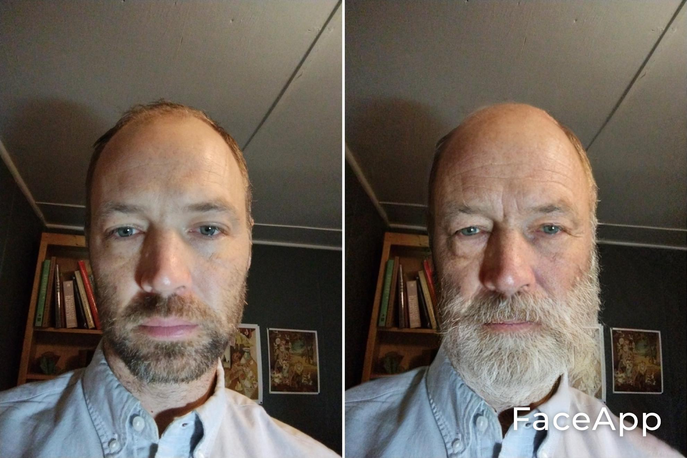
Why would I do that?
Even though it takes a few years.
There are some reasons to obtain a higher level of education:
To move up in your career
To make more money
To maintain your job
After Master’s degree
Before Master’s degree
Me at 40 and me at 80
hi

Slide 9
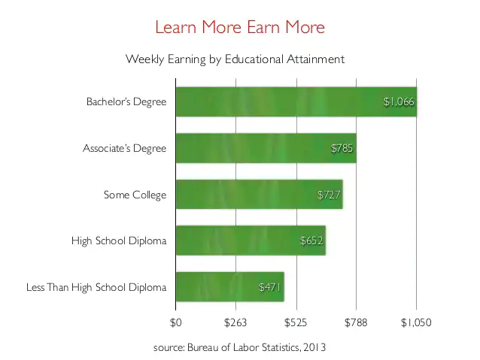
College Degree Levels
A person with a Bachelor’s degree on average earns $339 more a week than a person with just a high school diploma.
That is $17,628 a year and over half a million over 30 years of work.
hi

Slide 10
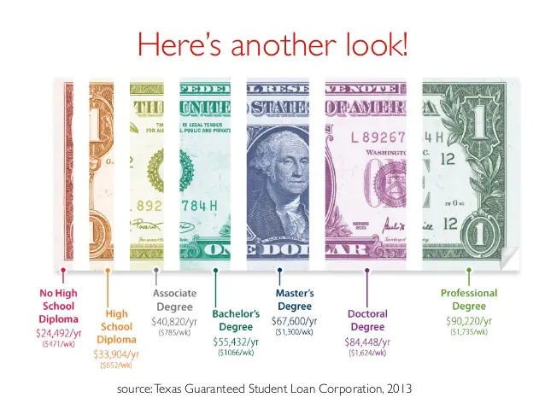
College Degree Levels
This is a look at the average yearly wage for a person with each education level.
hi

Slide 11
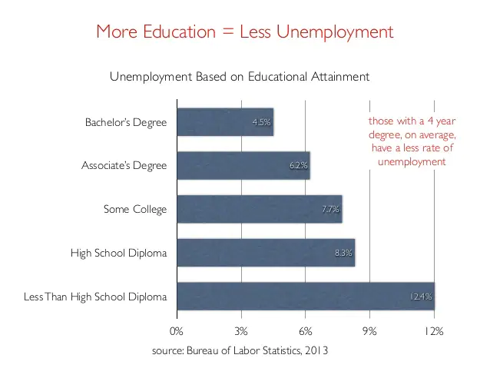
College Degree Levels
The more education you obtain the more likely you are to have a job.
The unemployment rate for a person with a Bachelor's degree is 4.5% compared to just a high school degree at 8.3%.
hi

Slide 12
Today’s College Prep Assignment
In the comments section of today’s College Prep,
answer the following question:
Using one of the majors you chose earlier, what degree does my future career require?
hi

